Slide 1
Movie Ticket Booking System
PREPARED BY:- Aman Vyas

Slide 2
Description
Describe the project in non-technical terms.
Use following slides for discussing status, schedules, budget, etc.
-for more info…List location or contact for specification (or other related documents)

Slide 3
Hardware and Software Required
After analyzing existing system to see which of their features ware useful and how they could be improved. The hardware and software requirements are sufficient for installing and running the application. Requirement for this project are:

Slide 4
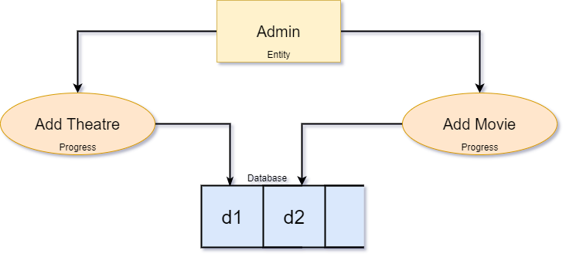
DATA FLOW DIAGRAM (DFD)

Slide 5
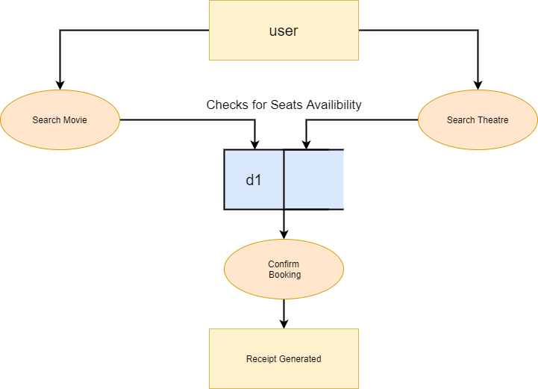
DATA FLOW DIAGRAM(DFD)

